Slide 1



Slide 2
Making cold calls
Cold call- An unsolicited phone call made to a potential donor who has no prior or recent relationship with you (Fundraising regulator)
As part of your challenge, you may wish to contact people in the community e.g. local businesses looking for raffle / auction prizes
Being confident using the telephone is a key work-related skill, the more practice you have, the more confident you will become
It is important to do some research on the people that you are calling
Know what your ‘ask’ is ahead of the call
Be familiar with Birmingham Hospice and the work that we do, use the Telephone Script on page 11 of the Support Pack

Slide 3
Key features of a good telephone manner
Speaking clearly and at a moderate pace (don’t rush)
Always be polite, courteous and respectful
Listen carefully, pay attention to what the other person is saying
Make notes where appropriate
Avoid distractions, make calls in a quiet room away from others
End the call professionally, summarising any agreed actions and thank the caller before saying goodbye politely

Slide 4
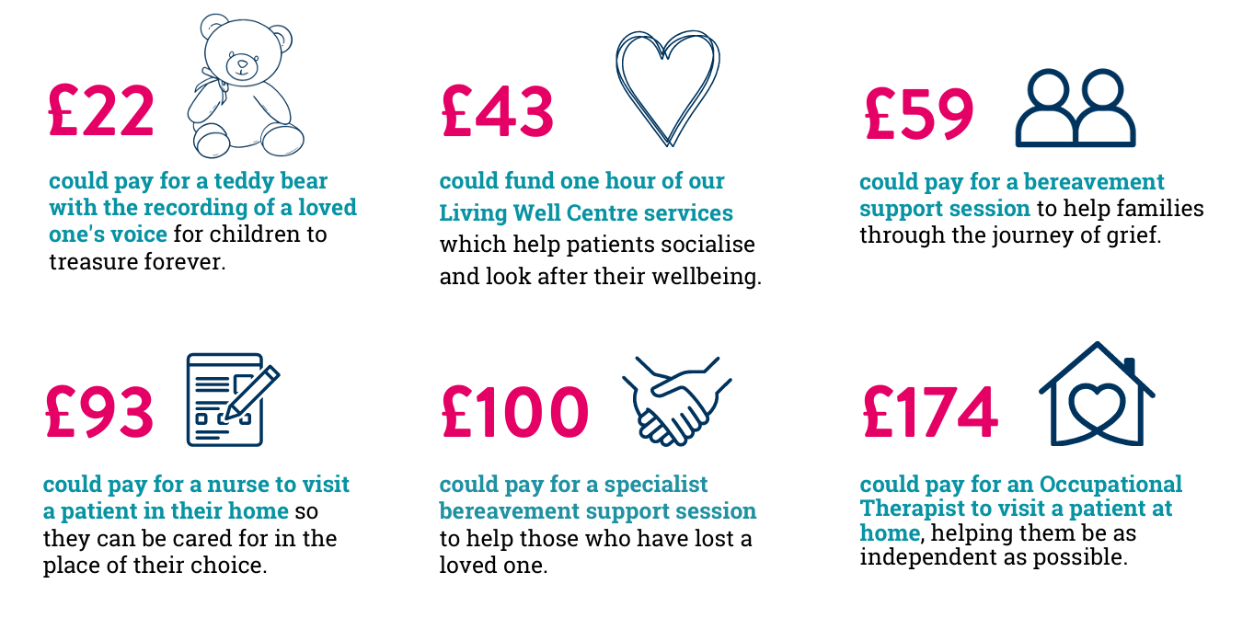
How your fundraising helps

