Slide 1



Slide 2
Time management
A key part of the challenge is managing your time effectively to ensure that you are meeting deadlines
You have between now and the end of term to raise your £500 in fundraising, so having a clear timeline will help you to achieve that
When your proposed timeline is complete all members of your group will have designated roles
This part of the challenge will help you to put your research and understanding of what is required into practice

Slide 3
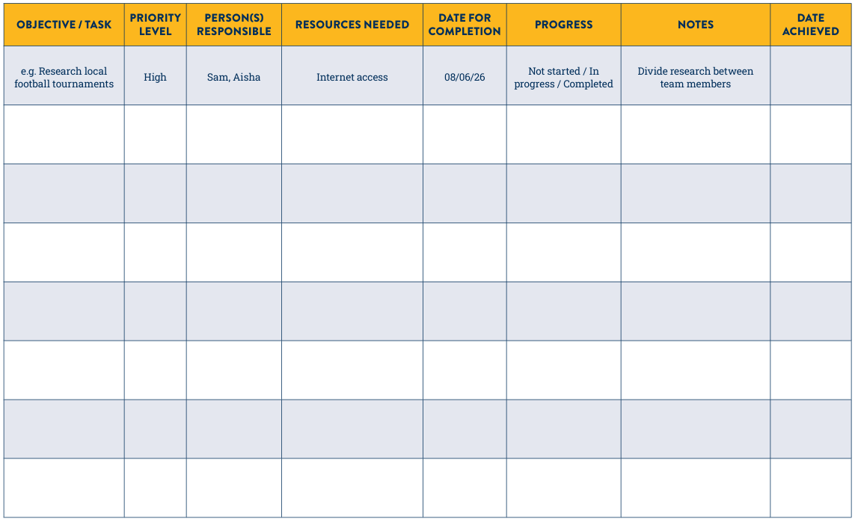
Timeline
Once group members know their objectives, they can begin to work through them
You may decide to assign tasks to suit group members’ skill sets or interests
Using simple progress updates such as ‘Not started’, ‘in progress’, and ‘Completed’ helps to keep track of tasks. It is important to date any information provided
Include any general notes so that all team members have as much information as possible
Establishing the resources needed is very important, as certain things will be less available than others
This will in turn impact the time allocated for the different resources
Understanding the priority level will be useful when organising your time
In general, the tasks with a ‘High’ priority level are likely to be required more urgently than those with a ‘medium’ or ‘low’ priority
When deciding on completion dates, it is a good idea to work backwards from the end point and consider how far in advance each objective will need to be met
Once tasks are complete note down the date in the end column

Slide 4
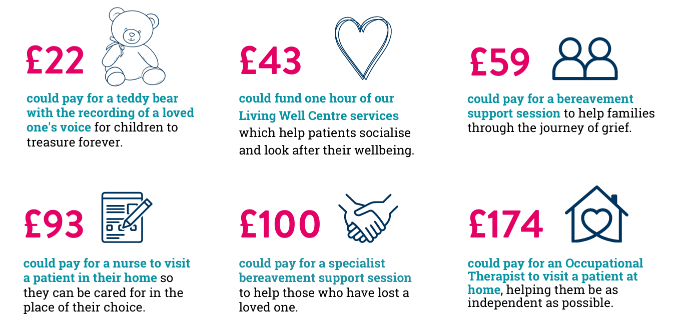
How your fundraising helps

