Slide 1



Slide 2
Budgeting
Definition: The process of calculating how much money you must earn or save during a particular period of time, and of how you will spend it (Cambridge Dictionary)
The budget to spend for the challenge is £50
As part of your planning, you will set a budget for spending and fundraising
This will help to ensure you don’t overspend and also predict the ROI (Return on investment)
In the support pack you will find a table for spending (page 7) and one for fundraising (page 8)
You may also choose to create an Excel Spreadsheet to help with your budget

Slide 3
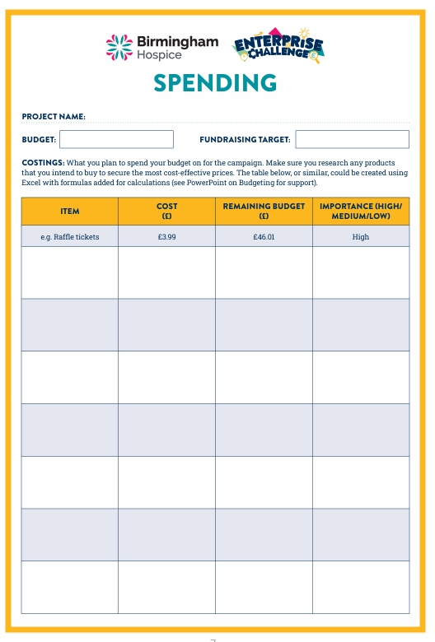
Spending
Once you have decided where your budget will need to be spent it is important to research prices for different items before including them on your table
You must then subtract that amount from your remaining total
Including the importance of an item will help to decide what is essential and what is desirable, ensuring that you keep to the budget
If the budget is tight the importance column will help to decide which items must remain

Slide 4
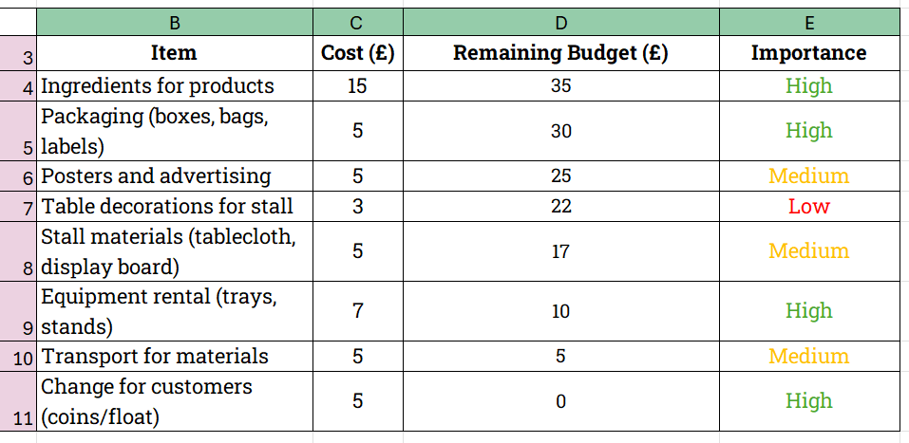
Spending
Using a basic Excel spreadsheet, like the one below, can help with budget planning
You can include formulas that will do the calculations for you
=SUM(50-C4)
=SUM(D4-C5)
=SUM(D5-C6)
=SUM(D6-C7)
=SUM(D7-C8)
=SUM(D8-C9)
=SUM(D9-C10)
=SUM(D10-C11)

Slide 5
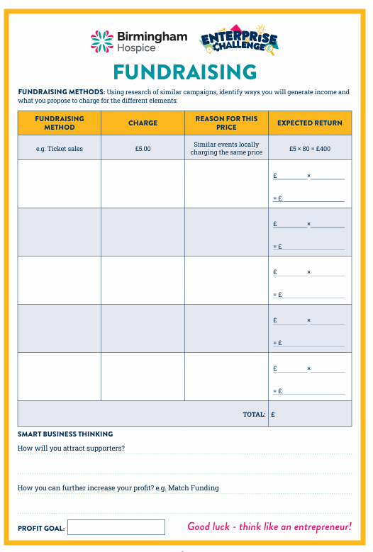
Fundraising
At this stage it is a good idea to research any similar campaigns for inspiration and to gauge income from the different methods
Giving a reason for the prices of different elements is also helpful
Once the above is in place you can then begin to focus on your expected return
Beginning to consider the ways of maximising profit is important, including how to attract supporters and further increasing profit
Having an overall profit goal gives you a total to work towards

Slide 6
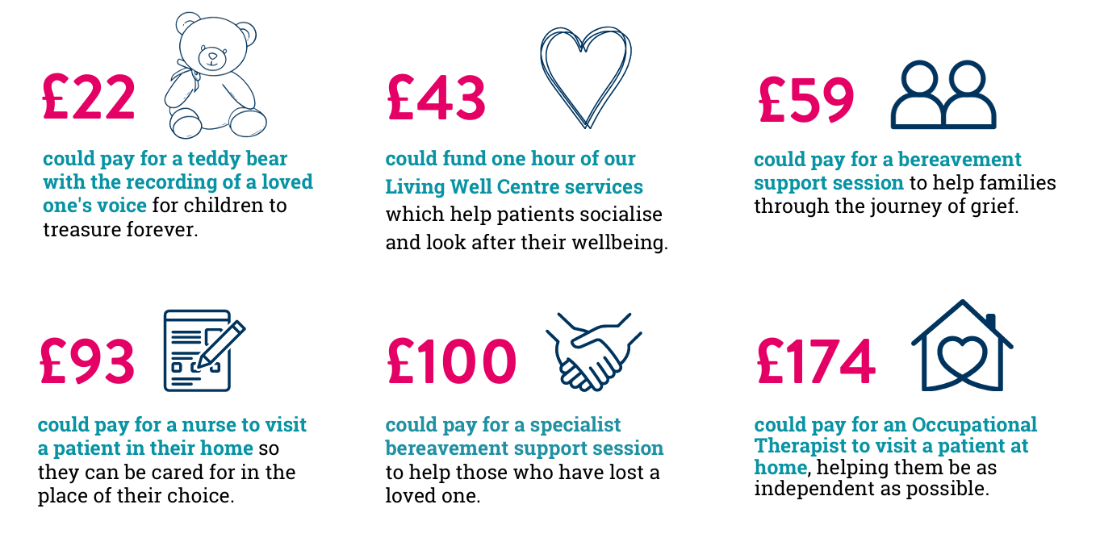
How your fundraising helps

