Slide 1



Slide 2
Planning your Enterprise Challenge
It is important that your challenge is well planned to ensure your community are getting maximum benefit from the experience and providing the greatest fundraising potential
Firstly, you must decide on what to do, whether it is an event or a sales initiative or anything else that would work for your community
Use the top 10 ideas sheet for inspiration, alongside carrying out your own research
Once the ideas start to flow, complete the planning table on page 6 of your support pack

Slide 3
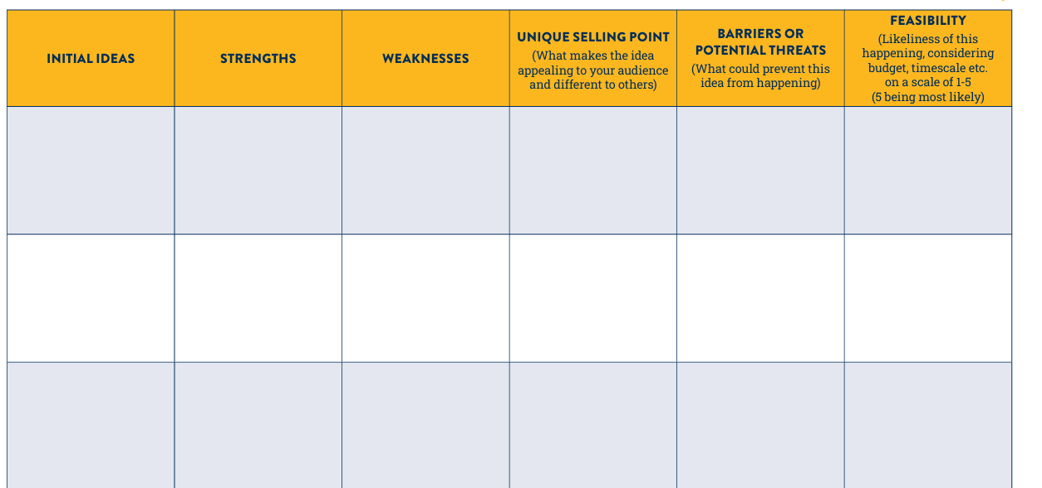
Planning table
Getting a range of ideas at this point will be helpful when deciding what will be most effective
Knowing the strengths of your ideas will be key to deciding on the challenge best suited to you and your community
This is where you are looking to stand out from the crowd and offer something unique and appealing
This might be a logistical factor. E.g. If you are planning to host a disco for 400 people but don’t have a space large enough
Understanding the weaknesses will ultimately help you to rule out some of your initial ideas
Accurate figures here will really help when reaching your final choice of what challenge to take on

Slide 4
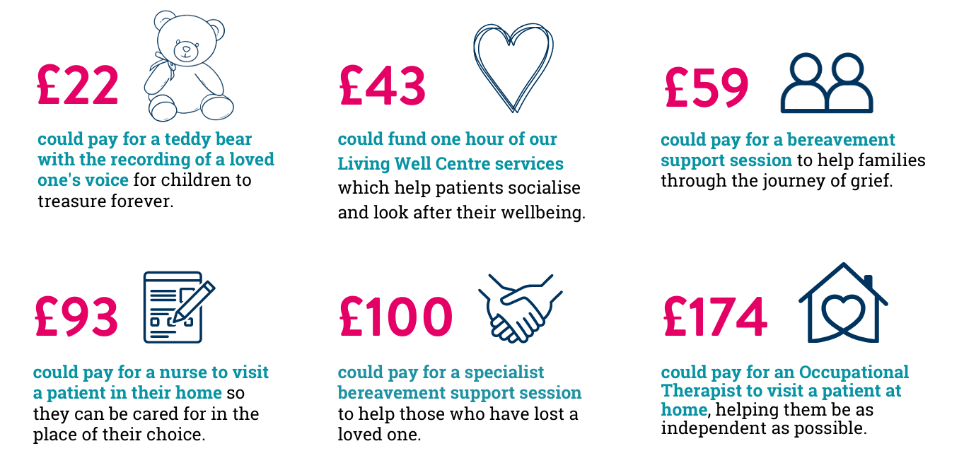
How your fundraising helps

